Slide 1
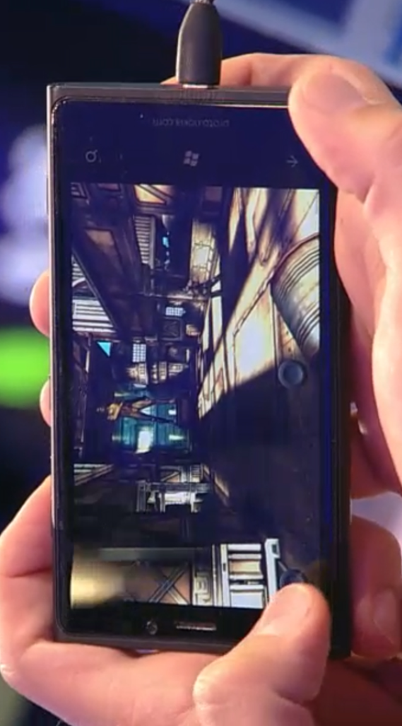


Day of Unity

Slide 2

David Crook
Technical Evangelist for Microsoft
Focus on Game and App Development Communities
Background in Enterprise Consulting and Game Development
Hobbies: Brewing Beer, Brazilian Jiu Jitsu
Email: dacrook@Microsoft.com
Twitter: @DavidCrook1988
Skype: DavidCrook1234
Web Site: www.IndieDevSpot.com

Slide 3

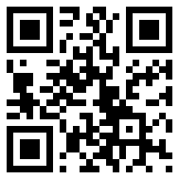
Michael Cummings
Michael Cummings is a Microsoft Developer Evangelist for Maine, New Hampshire, Vermont, New York, Massachusetts, Rhode Island and Connecticut. Talk to him about initiatives around BizSpark, Azure, Windows Phone, and Windows 8 in New England.
Phone: 781-373-8636
Email: cummings.michael@microsoft.com
Web: michaelcummings.net
Twitter: @mcummings
Skype: cummings.michael

Slide 4

Chris Martone
Self-employed, self-taught programmer
2+ years experience developing games with Unity and scripting in C#.
Previous experience with GameSalad, and Corona SDK using LUA.

Slide 5
Not From Here – Its OK!
http://tech-advisors.msdn.microsoft.com/

Slide 6
Agenda
Current Offers
DreamSpark/Bizspark
Why Windows 8 and Windows Phone 8
Publishing to Windows 8 and Windows Phone
What is the Intro to 2D section
What is the porting section
Free Assets and Tools

Slide 7

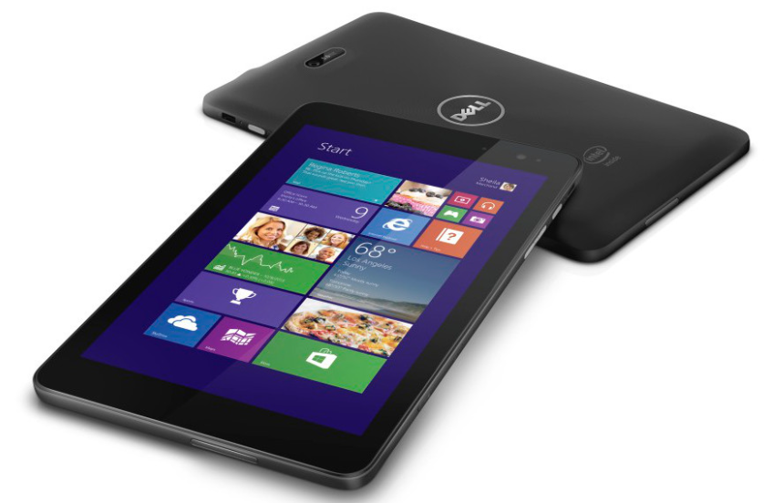
New York | http://aka.ms/BAMNewYork
Boston | http://aka.ms/BAMBoston
Rochester | http://aka.ms/BAMRochester
Atlanta | http://aka.ms/BAMAtlanta
Tampa | http://aka.ms/BAMTampa
Ft. Lauderdale | http://aka.ms/BAMFtLaud
Philadelphia | http://aka.ms/BAMPhilly
Raleigh | http://aka.ms/BAMRaleigh
Washington DC | http://aka.ms/BAMWashDC

Slide 8

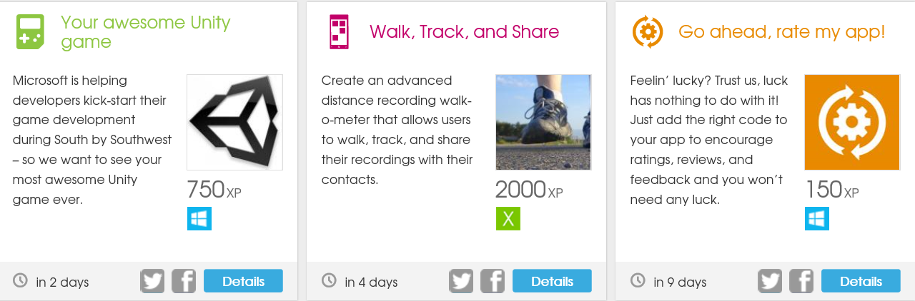
https://www.dvlup.com/

Slide 9
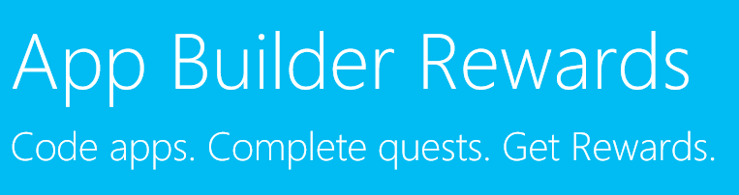
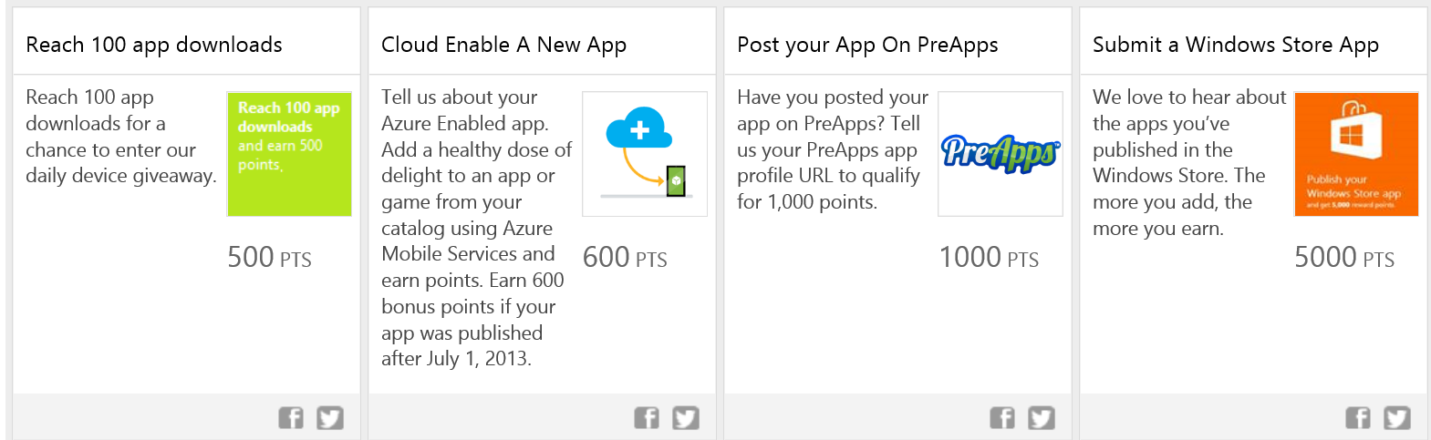
www.buildforwindows.com

Slide 10

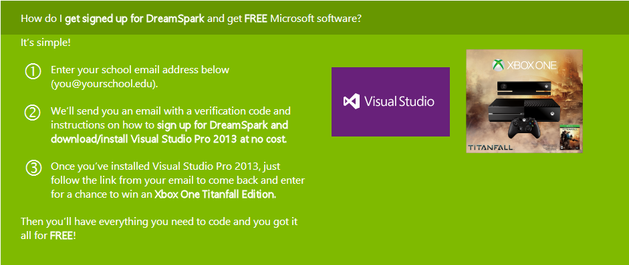
http://aka.ms/DreamSparkContest

Slide 11





BizSpark
Software
3 years free software/Development Tools
Windows Azure Credits $200 first month/$150 thereafter
Support
Professional technical and product support
Unique offers from Network Partners
Visibility
Profile, Offers and Events
Connection to the ecosystem
Opportunities for showcase, visibility (events, social media)
Is your startup:
Developing Software?
Privately held?
Less than 5 years old?
Making less than US $1M in annual revenue?
http://bit.ly/1dSq8l7
Notes:
bizspark is your pipeline to Microsoft software development tools. need proof? over 75,000 startups from more than 100 countries have already joined
Microsoft BizSpark is a global program that provides free software, support and visibility to help startups succeed
To qualify, startups must be:
Developing Software
Privately held and generating less than U.S. $1M in revenue per year
Less than 5 years old

Slide 12
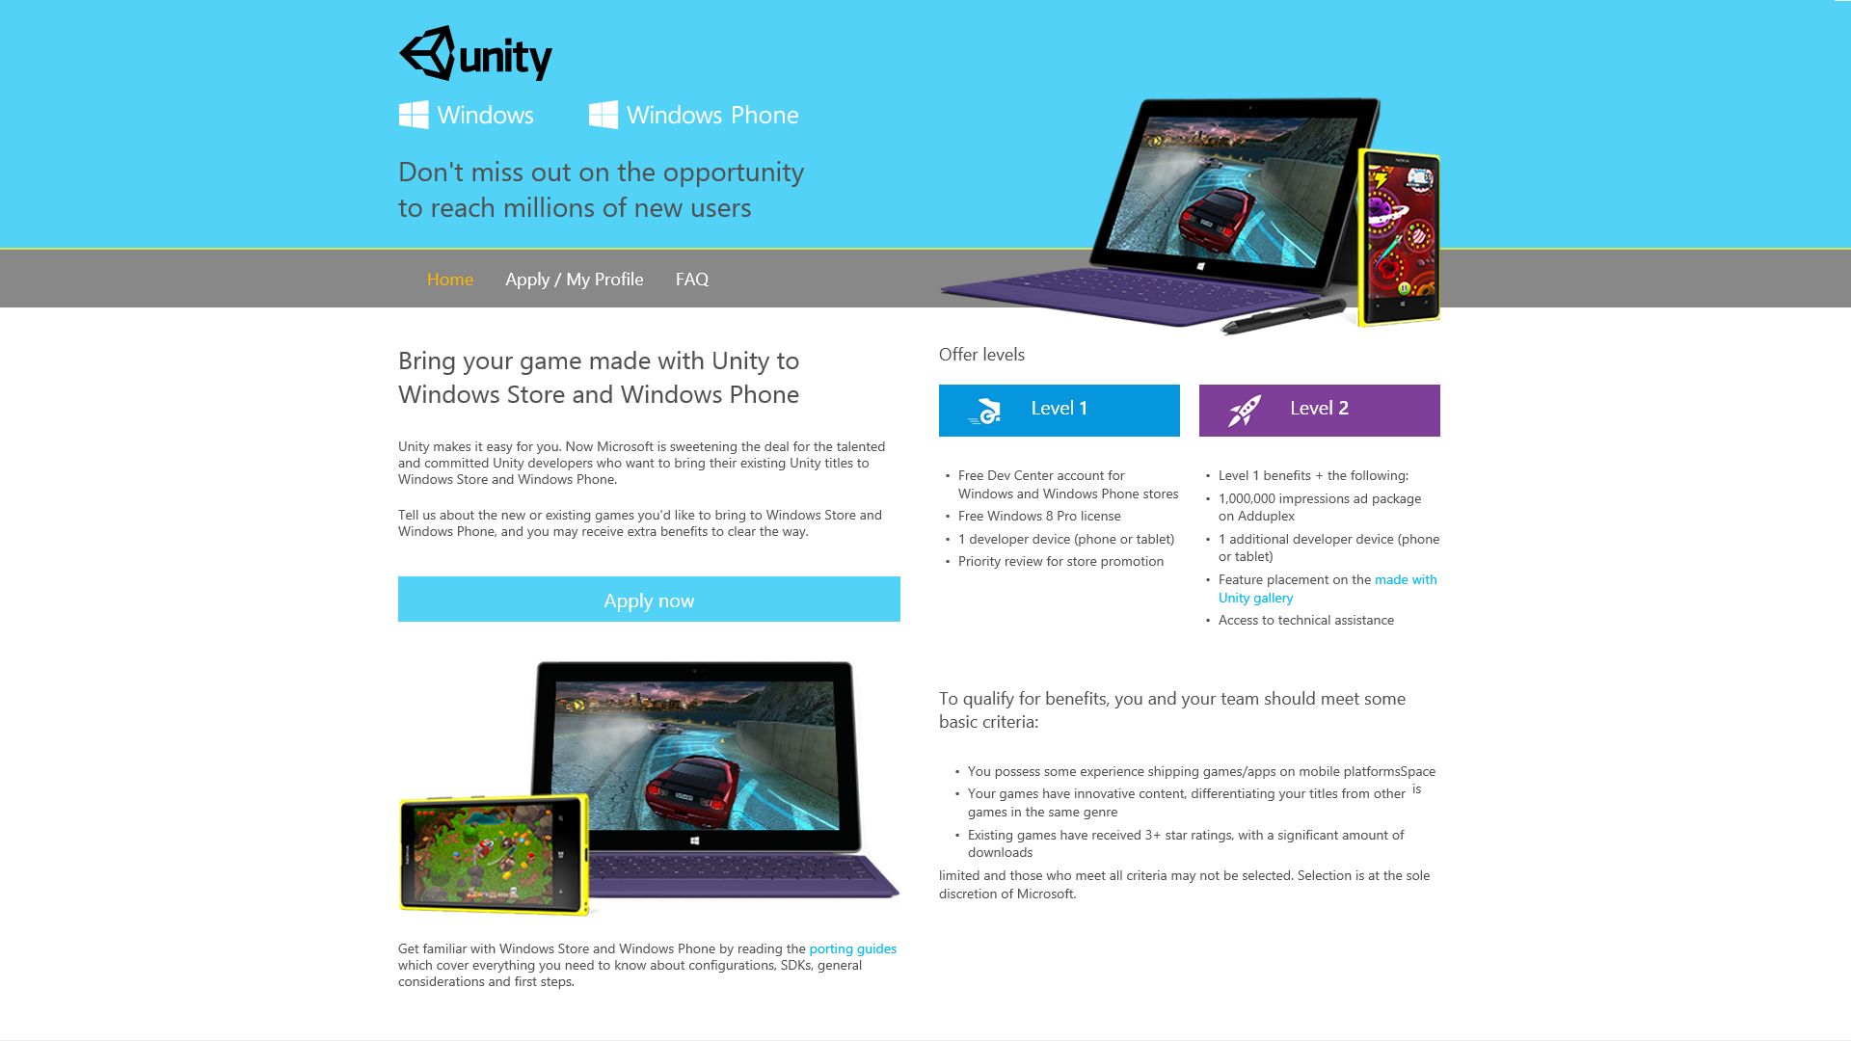
http://www.wpdevcenteroffers.com/

Slide 13
Why Windows Phone 8
Window Phone is currently growing faster than the phone market, and as of the latest figures is beating iPhone sales in 24 countries including India and Mexico, and is #2 in 10+ countries. There are more than 14 million downloads a day of apps on the phone alone. That’s nothing to shake a stick at. The Lumia 520 512 MB phone has sold more than any other Android phone – EVER. Again, not too shabby!

Slide 14
Why Windows 8 Store?
Windows Store applications run on the Windows 8 platform, not the phone which targets 3000+ different devices from hand held small tablets, larger tablets, laptops of all sizes, and of course desktop systems as well. Some folks new to the platform think this means only tablets, like a Microsoft Surface tablet. That’s not the case. Windows 8 runs on many device types as listed above. Every one of them can run a Windows Store app on it.

Slide 15
A few quick Quotes
Pat Toulouse, President and Founder of RatRod Studio “The process of porting our games to Windows and Windows Phone was very straight forward. Since then, it has helped us extend our reach by generating over 5 million downloads within the past 6 months. And this continues to grow rapidly”.
Magma Mobile’s CEO Nicolas Sorel: “first 1,000,000 downloads in 2 ½ months of being in the Windows Phone Store, and had 1,000,000 additional downloads in the last 30 days.”

Slide 16
Publishing to Windows
Some extra resources
www.IndieDevSpot.com
http://completedevelopment.blogspot.com/2014/04/how-to-port-unity-games-to-windows.html

Slide 17
Requirements
Unity 4.2 or Later
Developer account to publish to the stores http://msdn.microsoft.com/en-us/library/windows/apps/hh868184.aspx
Windows 8 / 8.1 (Free trial http://technet.microsoft.com/en-us/evalcenter/hh699156.aspx)
Windows 8 is freely upgradable to Windows 8.1
If you are on a mac see these links for getting Windows 8 running on it. You can either use boot camp or install it as a virtual machine running inside of OSX. For some common instructions here see
Virtual Box : http://blogs.technet.com/b/chrisavis/archive/2013/01/27/installing-windows-8-into-oracle-virtualbox-running-on-mac-os-x.aspx
Parallels : http://blogs.technet.com/b/haroldwong/archive/2013/02/05/configuring-a-mac-for-windows-8-and-windows-phone-development-with-parallels-8-installing-and-configuring-parallels.aspx
Visual Studio (Retail or the free Express edition)
If you have the retail version of Visual Studio 2013, you are potentially all set. You may need the Windows Phone 8 SDK installed however and that is available here http://www.microsoft.com/en-us/download/details.aspx?id=35471
If you want to develop for Windows Phone 8, http://www.visualstudio.com/downloads/download-visual-studio-vs#d-express-windows-phone
If you want to develop for Windows Store (Windows 8) http://www.visualstudio.com/downloads/download-visual-studio-vs#d-express-windows-8

Slide 18
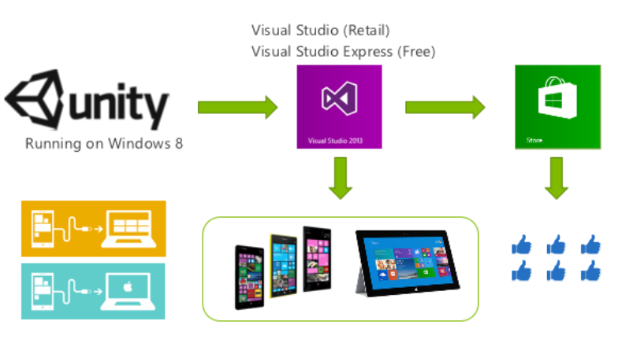
The Basics
Switch platform in Unity
Set player settings (images, icons, etc)
Build from Unity which creates a Visual Studio solution
Open solution in Visual Studio
Test the project and deploy to devices or local system (Note debug builds are slow, master builds are fastest more on this below)
Upload to the Windows Store and Windows Phone Store

Slide 19
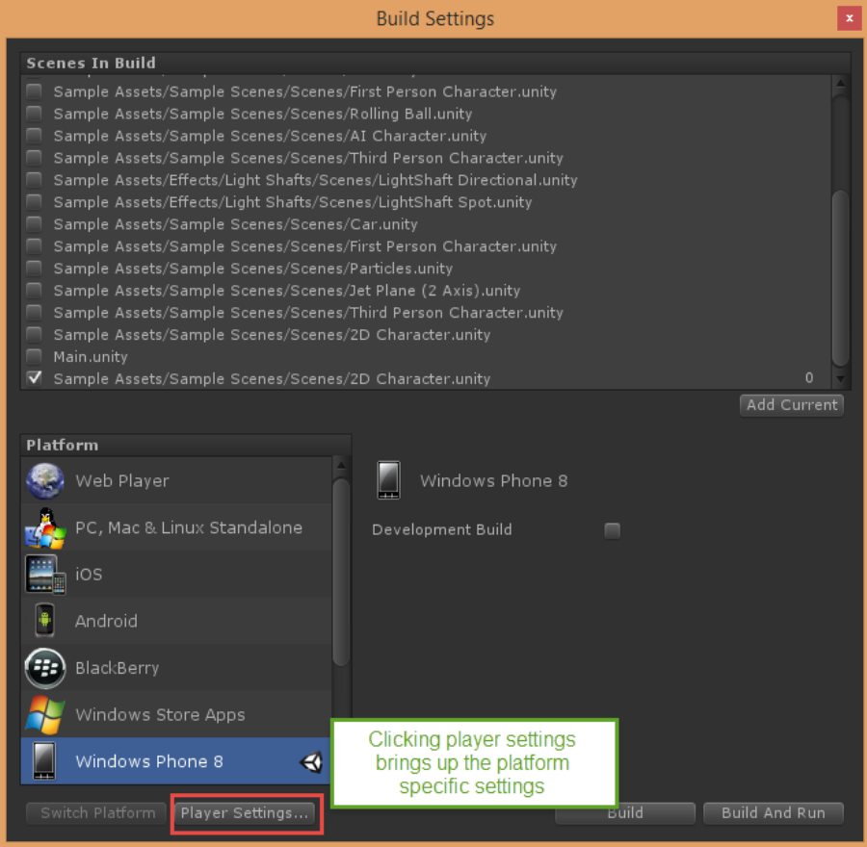
Switch Platforms
For a listing of pre-compilation directives see here
From Unity: File -> Build Settings
Player settings allows you to adjust some platform specific items.

Slide 20
Do some WinRT Code from Visual Studio
This is where you do platform interop (covered in porting section)
You can also do anything that overlays or interacts directly with the device

Slide 21
Windows Store Logos and Splashscreen
Before submitting to the store you need to provide a minimum of four graphics – three logos and a splash screen. These graphics have very specific size requirements (below) and should be .png or .jpg format. Use MS Paint or other free drawing tools to create these graphics.
Overwrite the existing file in the project directory (filenames below) with your custom graphics.
Asset | Filename | Size in Pixels
Logo | app-logo.png | 150 x 150
Small Logo | app-smallogo.png | 30 x 30
Store Logo | app-storelogo.png | 50 x 50
Splash Screen | splashscreen.png | 620 x 300

Slide 22
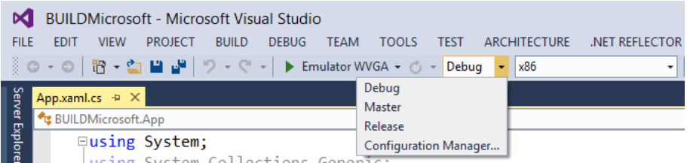
Build and Test Your Game
You will have to change your properties to x86 if testing locally, if testing on a remote Windows RT device, use ARM
Check out the //build video at the end for how you can debug Unity code in Visual Studio. You can’t do this in development without a third party plugin (UnityVS – well worth it - available here) but you can do this after you’ve built your solution from Unity out to Visual Studio by adding another project to your solution. The file to add is Assembly-CSharp-vs.csproj and this is a file that Unity creates for you.

Slide 23
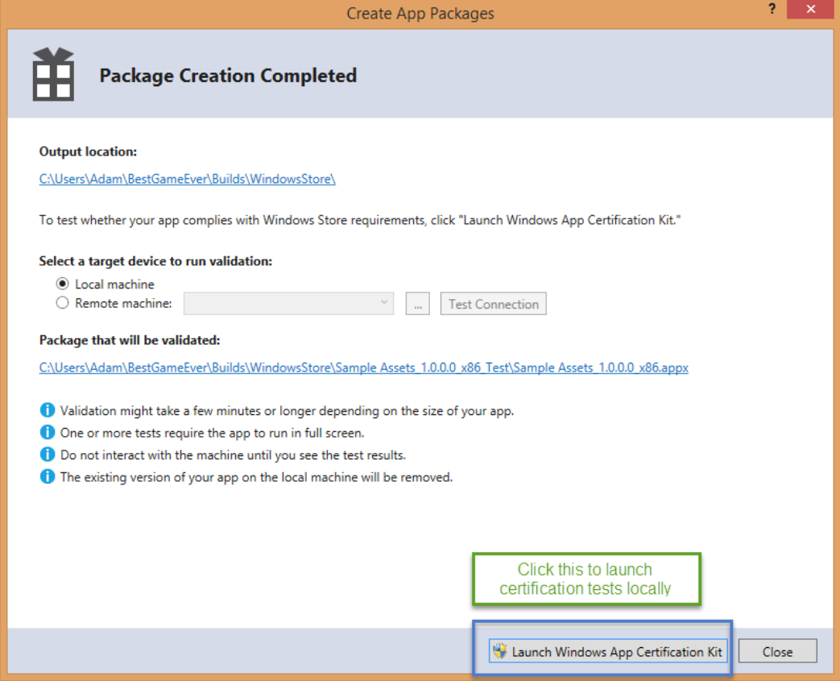
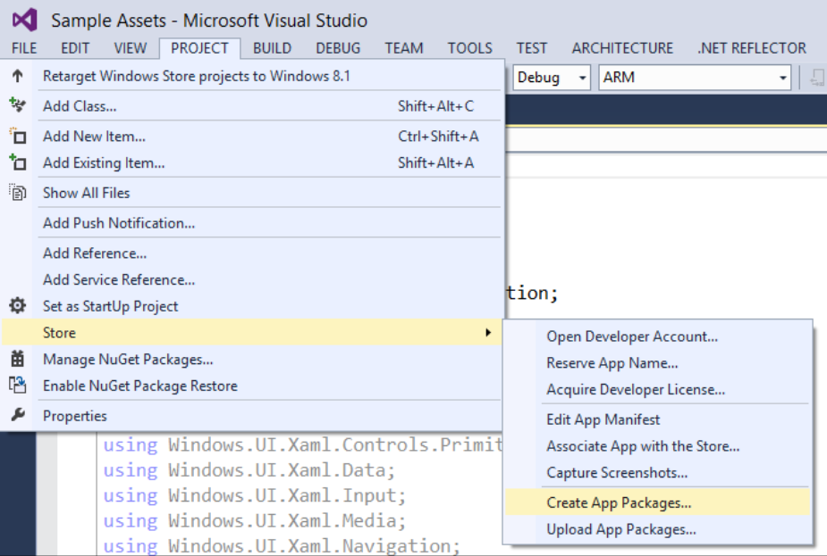
Create and Upload App Packages
Make sure you have a DevCenter subscription: http://msdn.microsoft.com/en-us/library/windows/apps/hh868184.aspx

Slide 24
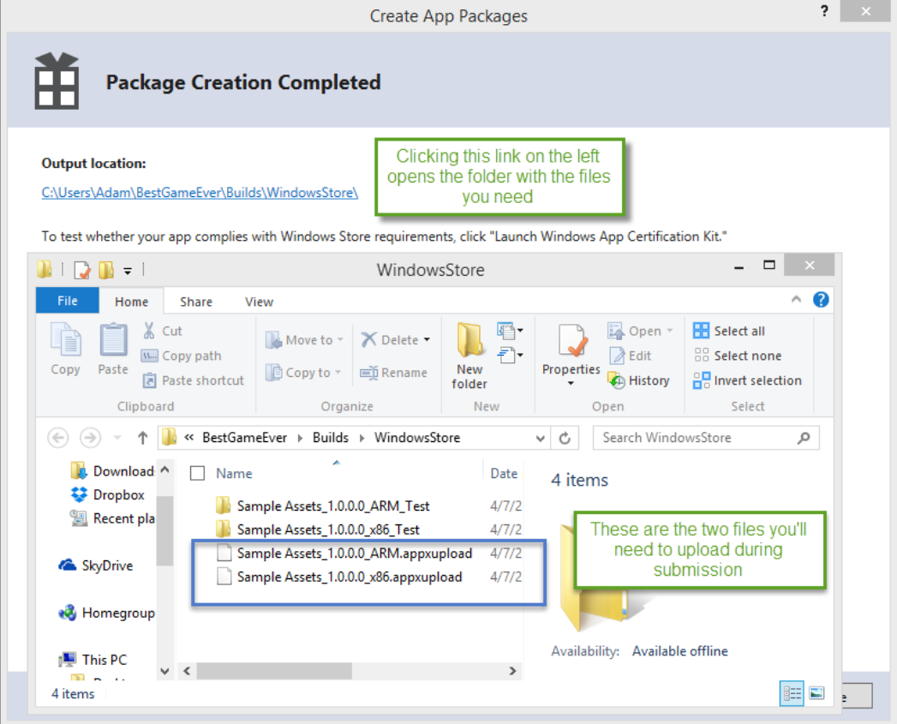

Slide 25
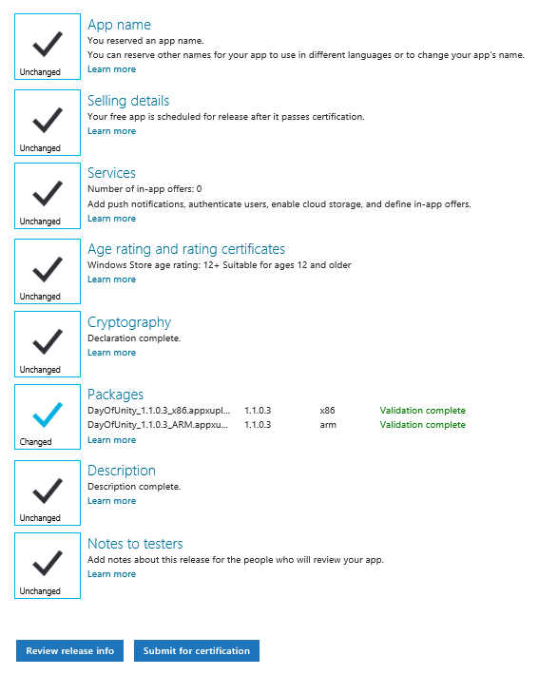
Submit Your Game
Note: If you do not have rating certifications and do not want to go through that process, for Age rating and rating certificates do the following:
12+ (or higher, note: Germany doesn’t allow 18+)
Do not deploy to these countries:
Korea
South Africa
Brazil
Taiwan
Russia

Slide 26
Other Considerations
Culture. Some countries have rules about specific content, you may fail for those reasons. Your submission report will contain details about it.
Tile and Text Contrast ratio. Dark Grey on a mostly Black background won’t pass certification. Make sure your tiles are all visible.
Touch Support is required. Many of the devices now are touch enabled.

Slide 27
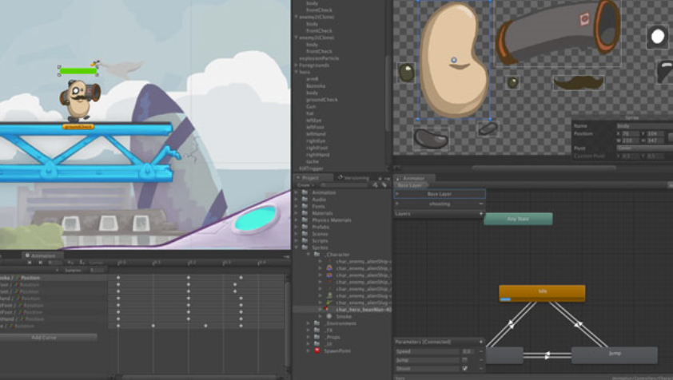
Intro to 2D Section
Beginner to Intermediate Experience
New to Unity
New to Game Development
Don’t have a game ready to port yet

Slide 28
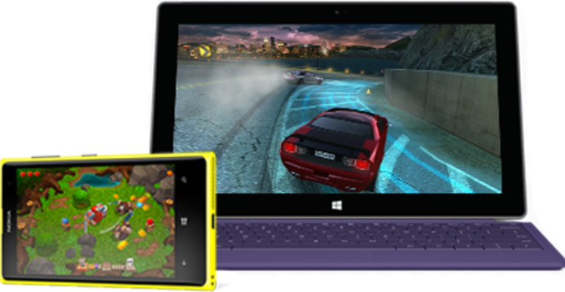
Porting Section
Much more advanced
Actually deploy or publish your game
Having platform specific issues?
Better understanding the Windows Platform as a target.

Slide 29
Free Resources
Music
Incompetech – Hundreds of high quality songs available for use in apps and games.
FreePD – Another great resource for finding free music in the public domain.
Sound Bible - Sounds clips
Audacity – good for editing your recorded sounds
Fruity Loops Demo – pro grade music creation
Sprites
HasGraphics Sprites – 10 sprite sets free for commercial use. Some require attribution, some do not.
Video Game Sprites - Actual sprites from original games, not able to use in commercial games
Lost Garden – Game graphics, asks for acknowledgement.
Open Game Art – Graphics, sprites, icons and sounds. Asks for donations.
Textures
CGTextures – Amazing, pretty exhaustive collection of tillable textures.
HasGraphics Textures – Two large tile sets free for commercial use.
Max Textures - Tiled/seamless textures

Slide 30
Free Resources - Part 2
Icons
Metro Studio – 600 free metro style icons from the cool folks at SyncFusion.
The Noun Project – Hundreds (if not thousands) of icons for just about anything you can think of, all free.
BRKR Design Icon Pack – This pack costs $20 but it includes 350 of the most commonly used icons already sized
Images
Every Stock Photo – Search thousands of images, many of which can be used in apps and games. Open Clip Art
Clker
Funplosion
Iron Star Media
Jesse Freeman’s Game Artwork

Slide 31
Break!
Take a 15 minute break
Take a vote for which section
Understand audience’s technical depth.
Adjust sections accordingly

